Slide 1
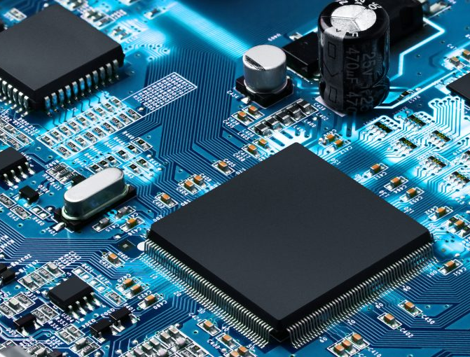



PEMROSESAN PARALEL
CCE60218

Slide 2
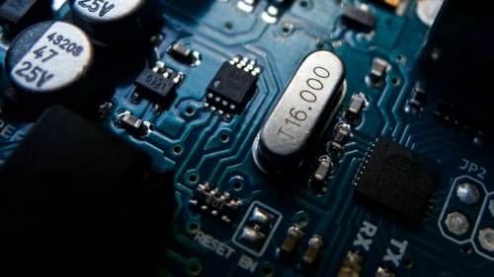
Implicit & Explicit Parallelism

Slide 3

What is the difference?
Implicit Parallelism
Programmer does not define how computation is parallelized
Compiler parallelize the execution automatically
Language’s constructs are inherently parallel
Explicit Parallelism
It is explicitly defined by the programmer
Can be difficult to program, debugging is hard
Examples: threads, OpenMP, MPI, etc.

Slide 4
Languages Example of Implicit Parallelism
HPF (High Performance Fortran)
LabVIEW (Laboratory Virtual Instrumentation Engineering Workbench)
MATLAB
NESL
SISAL
ZPL

Slide 5
Explicit Parallelism
Thread (Concurrency)
Asynchronous (Concurrency)
Multiprocessing
OpenMP
MPI

Slide 6
Parallelism & Concurrency
Concurrency
[Threading, Async IO, etc.]
1 processor
Parallelism
[Multiprocessing, etc.]
Many processors

Slide 7
Parallelism & Concurrency
Orange: Running program.
Orange: Running program.
Parallel
Concurrent
Task-3
Task-3
Task-2
Task-2
Task-1
Task-1
t
t
Blue: The complete task (from start to finish).
Blue: The complete task (from start to finish).

Slide 8
Parallelism & Concurrency
NO | Concurrency | Parallelism
1. | Concurrency is the task of running and managing the multiple computations at the same time. | While parallelism is the task of running multiple computations simultaneously.
2. | Concurrency is achieved through the interleaving operation of processes on the central processing unit(CPU) or in other words by the context switching. | While it is achieved by through multiple central processing units(CPUs).
3. | Concurrency can be done by using a single processing unit. | While this can’t be done by using a single processing unit. it needs multiple processing units.
4. | Concurrency increases the amount of work finished at a time. | While it improves the throughput and computational speed of the system.
5. | In concurrency debugging is very hard. | While in this debugging is also hard but simple than concurrency.

Slide 9
Parallelism & Concurrency
Concurrency Type | Switching Decision | # Processors
Pre-emptive multitasking (threading) | The operating system decides when to switch tasks external to Python. | 1
Cooperative multitasking (asyncio) | The tasks decide when to give up control. | 1
Multiprocessing (multiprocessing) | The processes all run at the same time on different processors. | Many

Slide 10
Threading
Thread: A thread is the unit of execution within a process. A process can have anywhere from just one thread to many threads.
Process
Thread 1
Thread 2
Thread 3
time

Slide 11
Multithreading in Python
import threading
import time
def func():
print('ran')
time.sleep(1)
print('done')
x = threading.Thread(target=func)
x.start()
print(threading.activeCount())
ran
2
done

Slide 12

Terima Kasih

